Slide 1
Preferred locations for a tourism business
Gerhard Basson

Slide 2
Introduction
Most major cities are marketed based on their tourism potential.
Some of these places are only known by the locals.
If a person wants to start a tourism business (or an existing tourism company wants to expand), it would be wise to have a premises in close proximity to tourism venues, so that you can also play the role of tourist guide.

Slide 3
Combining Data
A website advertising commercial properties for sale in Cape Town is used to obtain information about the location, neighbourhood and selling price.
Taking the centre of Cape Town as a starting point, data is obtained from Foursquare about points of interest near Cape Town within a 50 Km radius. The name, location, distance from city centre and popularity index is obtained.

Slide 4
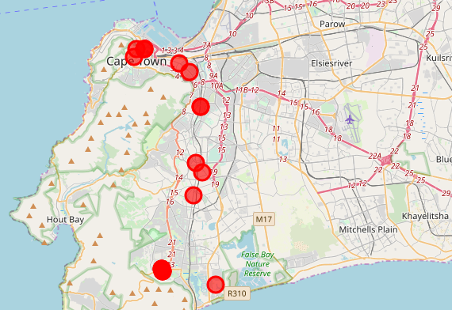
Commercial Properties for sale per Neighbourhood
Address | Neighbourhood | City | Price
2 Riebeek Street | Cape Town City Centre | Cape Town | 13440000
2 Riebeek Street | Cape Town City Centre | Cape Town | 26848000
2 Riebeek Street | Cape Town City Centre | Cape Town | 4376960
255 Long Street | Cape Town City Centre | Cape Town | 28500000
56 Shortmarket St | Cape Town City Centre | Cape Town | 6900000
Colosseum 3 St Georges Mall | Cape Town City Centre | Cape Town | 3750000
71 Capricorn Drive | Capricorn | Cape Town | 21000000
443 Main Road | Observatory | Cape Town | 8500000
170 Main Road | Plumstead | Cape Town | 0
7 Station Road | Rondebosch | Cape Town | 5200000
7 Station Road | Rondebosch | Cape Town | 3200000
C11 Westlake Square | Westlake | Cape Town | 1540000
D17 Westlake Square | Westlake | Cape Town | 1720000
F1 Westlake Square | Westlake | Cape Town | 1800000
F2 Bell Crescent | Westlake | Cape Town | 1960000
F2 Bell Crescent | Westlake | Cape Town | 3420000
F2 Bell Crescent | Westlake | Cape Town | 1740000
66 Victoria Road | Woodstock | Cape Town | 8500000
3 Riverstone Road | Wynberg | Cape Town | 2170000
59 Innis Road | Wynberg | Cape Town | 5250000
Woodstock
Cape Town City Centre
Observatory
Rondebosch
Wynberg
Plumstead
Westlake
Capricorn

Slide 5
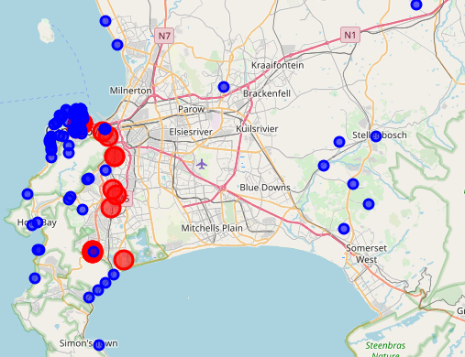
Points of interest superimposed on property locations
The available properties in the city centre are also closest to the most points of interest
Cape Town City Centre
Woodstock
Observatory
Rondebosch
Wynberg
Plumstead
Westlake
Capricorn

Slide 6
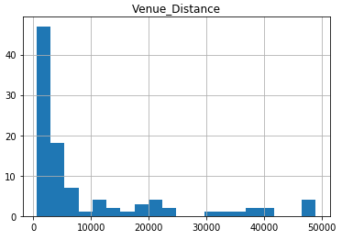
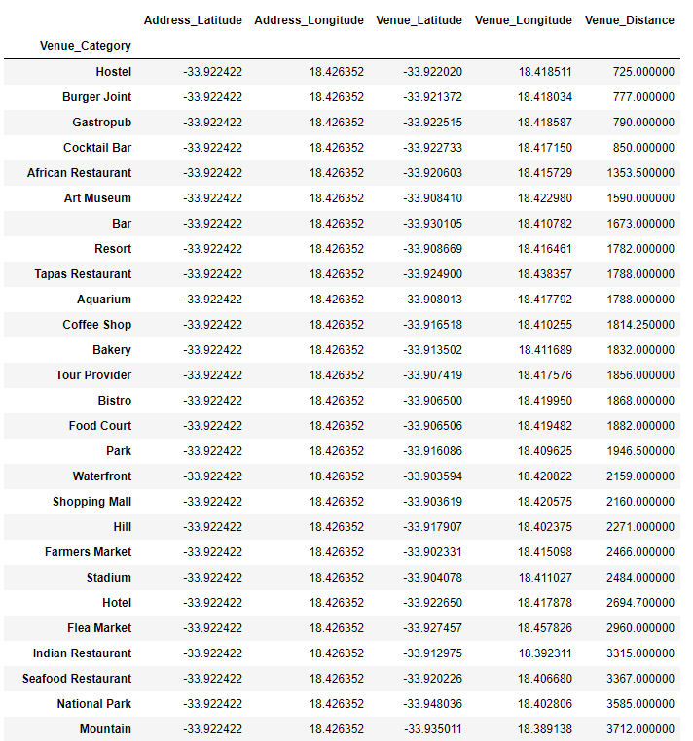
Venue distance from City Centre
Most venues are less than 3 Km (30 000m) away from the city centre.
The average distance to social venues and hotels are closer to the centre (hotels at 2.694 km).

Slide 7
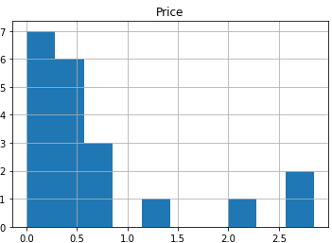
Average Price
Neighbourhood | Price
Plumstead | 0
Westlake | 2030000
Wynberg | 3710000
Rondebosch | 4200000
Observatory | 8500000
Woodstock | 8500000
Cape Town City Centre | 13969160
Capricorn | 21000000
There are more properties priced towards the lower half (ignoring the 0) than in the higher half.
The properties in the city centre or priced on the higher end.

Slide 8
Discussion
The commercial properties in the centre of the city are closest to important points of interest, such as hotels (if one needs to meet with the tourists or provide transport).
As one can expect, the properties in the City Centre are priced higher.
If one can arrange transport intelligently (such as collaborating with transportation companies), the proximity of the property should not be a problem.

Slide 9
disclaimer
Aspects such as the size of the property, access to major routes and accessibility for patrons are not taken into account.

Slide 10
conclusion
Of interest:
Properties available in Wynberg (average price of R 3 710 000) and Rondebosch (average price of R 4 200 000) should be considered first.
Properties in Woodstock and Observatory seems a good choice as to their closer proximity to the city centre, but at a higher price (average price of R 8 500 000).
Possible interest:
The properties in Cape Town City Centre comes with a high price tag, but are closer to all the venues. This should be considered last.
Property in Plumstead does not have a price (POA), but this could be good for negotiation.
Not of interest:
Properties in Westlake, although at a lower average price (R 2 030 000), are further away from the city centre and does not seem to be close to major routes.
Properties in Capricorn seem to be an outlier: high price tag and further from the city centre.
Woodstock
Cape Town City Centre
Observatory
Rondebosch
Wynberg
Plumstead
Westlake
Capricorn

